Slide 1

TECHNERDS
TURNING DREAMS INTO CODE

Slide 2
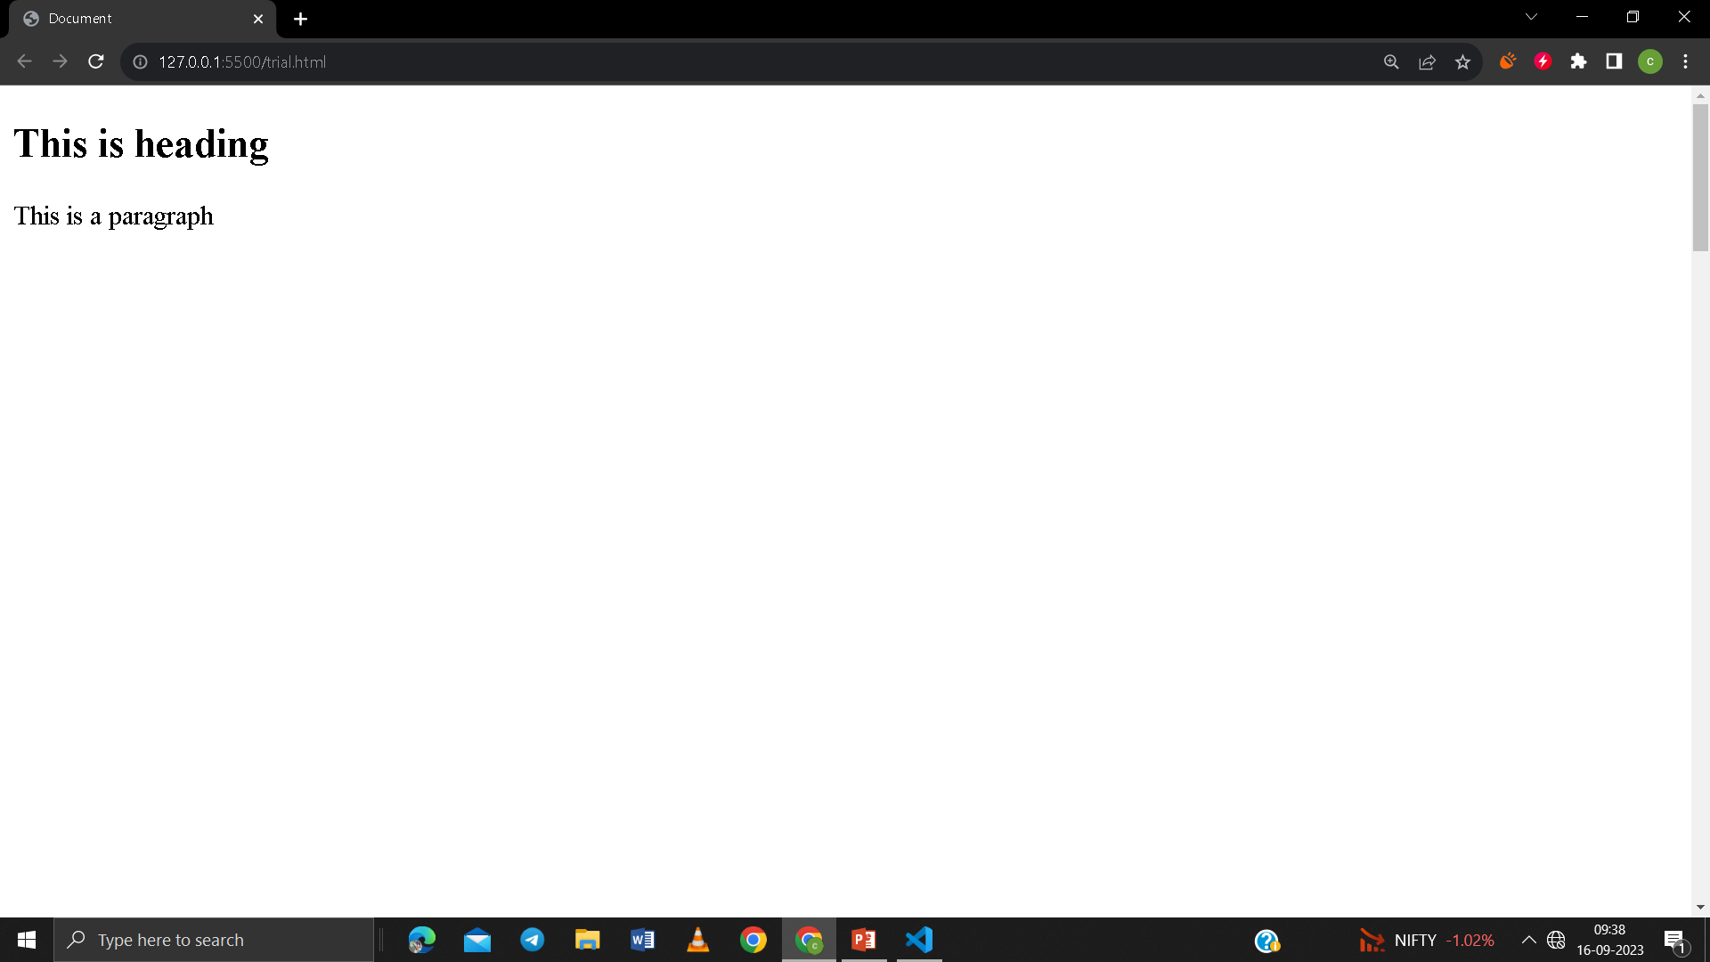
BASIC HTML STRUCTURE
<!DOCTYPE html>
<html>
<head>
<title>Document</title>
</head>
<body>
<h2>This is heading</h2>
<p>This is a paragraph</p>
</body>
</html>

Slide 3
ELEMENTS OF HEAD TAG
<title> => Used to give title to the web page
<style> => Used to define style information for the web page
<script> => Used to embed client side script
<link> => It defines the relation between current document and external resources
<meta> => It defines metadata about the HTML document

Slide 4
HTML BASIC TAGS
<html>
<head>
<title>
<body>
<h1>,<h2>,…,<h6>
<p>
<pre>
<br>
<hr>
<marque>
Attributes : behavior, direction
COMMENTS : <!-- … -->
SINGLE LINE
MULTI-LINE

Slide 5
TEXT FORMATING TAGS
Bold or strong <b>/<strong>
Italic or emphasis <i>/<em>
Small <small>
Big <big>
Superscript <sup>
Subscript <sub>
Strikethrough or delete <del>/<strike>
Underline or inserted <ins>/<u>

Slide 6
TEXT FORMATING TAGS
Highlight <mark>
Abbreviation <abbr>
Definition element <dfn>
Cite <cite>
Blockquote <blockquote>
Quotes <q>

Slide 7
Multimedia
Image
Tag used <img>
Attributes used src, alt, height, width
Audio
Tag used <audio>
Attributes used src, controls, autoplay, loop, muted
Video
Tag used <audio>
Attributes used src, controls, autoplay, loop, muted, poster, height, width
Gif
Tag used <img>
Attributes used src, height, width

Slide 8
Anchors and hyperlinks
Tag used <a>…</a>
Attributes used
href
title
target : _blank, _self, _top, _parent
download
Uses of anchors
Link to another site
Link to an anchor
Link that dials a number
Link that runs email clients

Slide 9
Lists
Ordered list
Tags used : <ol>, <li>
Attributes : type = 1, A, I, i, a ; start, value
Unordered list
Tags used : <ul>, <li>
Attributes : type = disc, square, circle
Nested list
Definition list
Tags used : <dl>, <dt> , <dd>

Slide 10
Tables
Tages used
<table>
<th>
<tr>
<td>
Attributes used
Border
colspan
rowspan
Cellspacing
bgcolor
 | Vertical Head 1 | Vertical Head 2 | Vertical Head 3
Horizontal Head 1 (Row span)
Horizontal Head 2
Horizontal Head 3 | (Colomn span)

Slide 11
HTML PAGE LAYOUT
HEADER
NAVIGATION BAR
INDEX/SIDEBAR
CONTENT SECTION
Tag used
<header>
<nav>
<footer>
FOOTER

